Slide 1
EMG PROJECT
Esra Firkat YILMAZ
Arif Emre YILDIZ
Talha Üstündağ
Samet YILMAZ

Slide 2
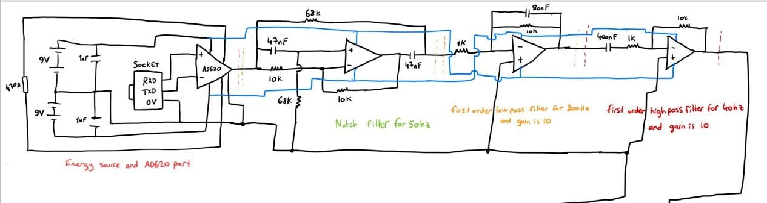
The Designed Circuit To Acquiring, Filtering, and Amplifying the EMG Signal

Slide 3
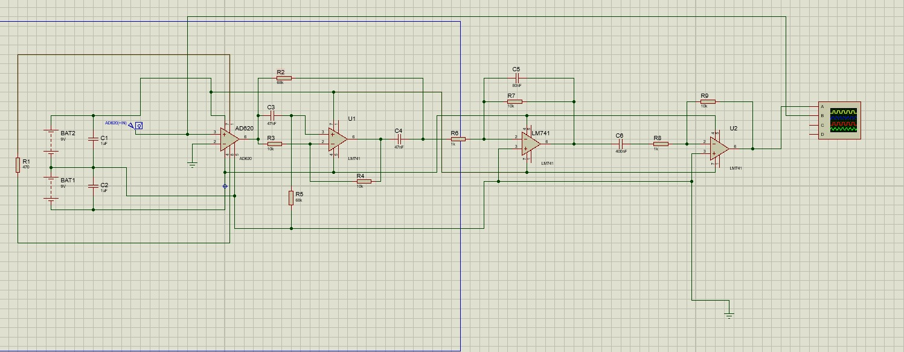
The Designed Circuit was tested Proteus.

Slide 4
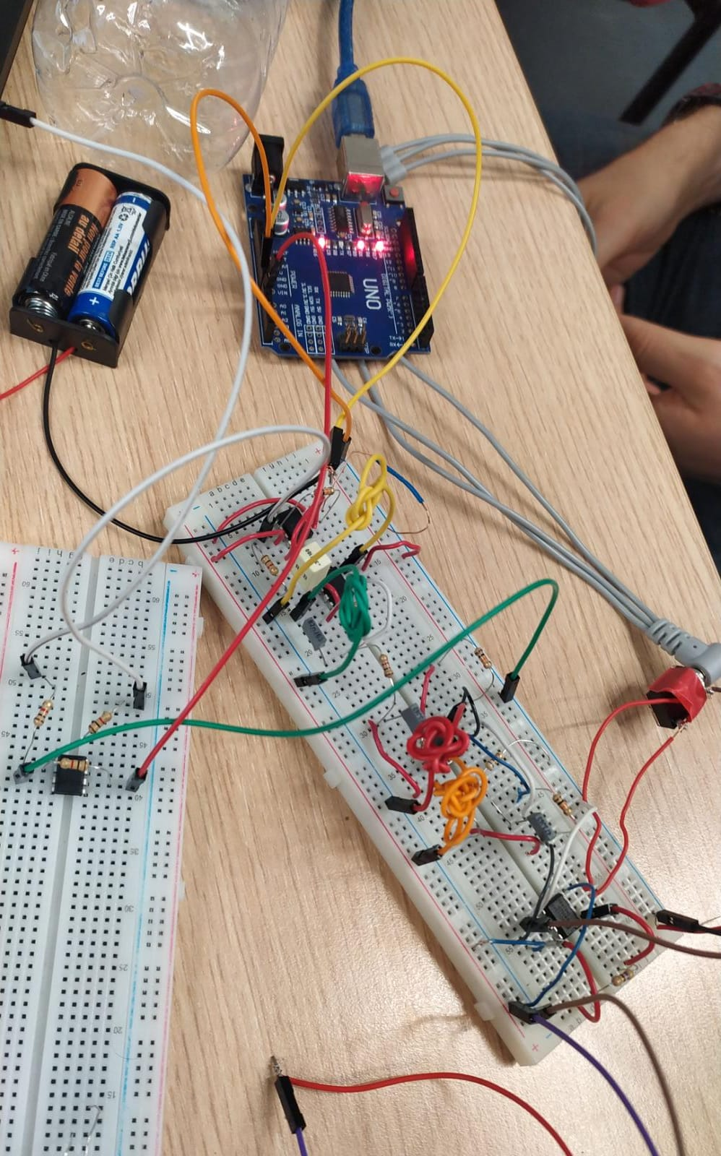
The Designed Circuit was tested on a breadboard.
You need to download the document to be able to run the videos

Slide 5
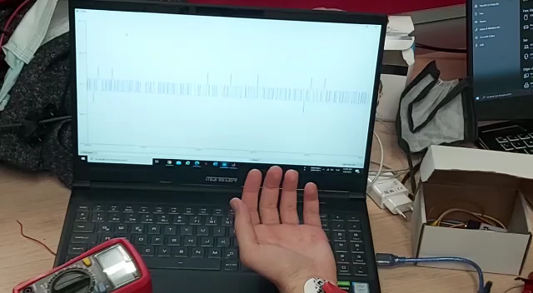
You need to download the document to be able to run the videos

Slide 6
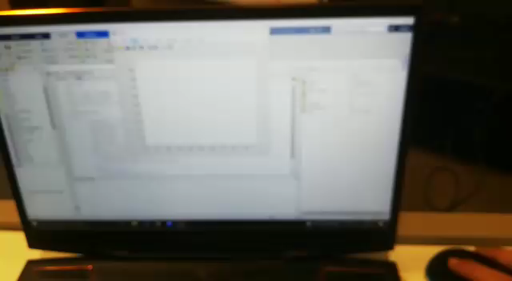
Real time plotting of EMG signal in MATLAB.
In this video the circuit was set on a stripboard.
You need to download the document to be able to run the videos

Slide 7
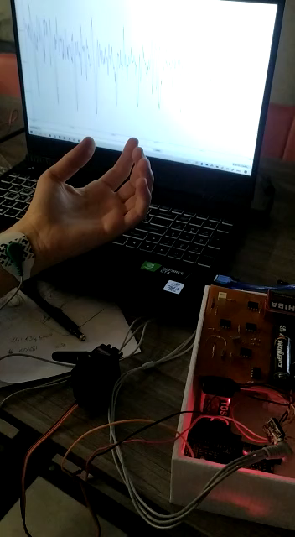
Controlling a servo motor

Slide 8
THANK YOU FOR LISTENING

